Slide 1
Module 7:
Essential Counseling Techniques
NUT 3700: Nutrition Education and Counseling

Slide 2
Today
Objectives:
Introduce the big picture of nutrition counseling
Develop skill for asking open ended questions
Practice building understanding and rapport with mirroring and affirming techniques
Agenda
Student Presentations
RECAP
Introduce nutrition counseling and open ended questions
Class and small group practice with open questions
Introduce affirming and mirroring
Class practice with affirming

Slide 3
RECAP
Reflection on health disparities discussion
Teach-back method review

Slide 4
NUTRITION COUNSELING
It’s a process!
The counseling relationship is key
Notes:
What metaphor is best for looking at Nutrition Counseling? It may seem at times like a consumer transaction. The clients pay you and you hand them information. Another model is that of education/imparting information. Both of these processes do happen during nutrition counseling, but a more useful metaphor for the overall process is that of a collaborative team. You and the clients work together on their health goals. This is the approach adopted by Academy’s Nutrition Care Process. There are specific counseling strategies and ways for you to be with a client that support that person to move toward positive change. Education alone is not as effective as when the education is embedded in a counseling process.

Slide 5
What happens in a GREAT nutrition consult?
What happens in a not so great consult (what are the pitfalls)?

Slide 6
THE OVERALL GOAL OF NUTRITON COUNSELING
Notes:
Whether you work alone in a private practice, or are part of the medical team. Your part is to help the client/patient reach their goals with respect to nutrition/metabolism/body composition/ health measures such as cholesterol….
As RDs in most cases we do not “apply treatment” the way surgeons or nurses do. The client applies the treatment themselves by choosing, preparing and eating food. Therefore our job is to help the client apply the treatment effectively. In order to do this, the client will need to make some behavior changes. So the information/education we provide is vital but only a portion of what the client needs in order to make changes.
So let’s look at the process of humans undergoing change…

Slide 7
THINK ABOUT CHANGE
Notes:
(A brief visualization to help the student understand the position a patient may be in.)
Think about a change you have been wanting to make for some time that you have not made yet. Not necessarily about health behaviors. Could be a household chore. These are the New Year’s resolutions-type behaviors.
From where you sit with that behavior right now, how does it feel? Notice where in your body you feel it. What do you say to yourself (and others) about it? Give them a moment.
Gather responses without talking about the specific behavior.

Slide 8
WE ALL CHANGE WHEN…
we want to, it matters to us
we know how
we believe we can
Notes:
Change does happen all the time…Change is easy and we all do it naturally and smoothly throughout our lives…. When things line up right.
1. “We want to” includes that is it important to us, it matters. We believe it will do us (or someone we care about) some good.
2. We have the skill, knowledge, resources, etc. As professionals that may be our role. (often the easy part)
3. We believe we can (self-efficacy or confidence)

Slide 9
2 Important Aspects
READINESS FOR CHANGE:
  Importance
  (What will I gain or lose if I change)
  Confidence
  (How will I do it and can I?)
Notes:
This then is one way to look at assessing and working with readiness for change.
This way of looking at it tends to keep our attention on the client and ourselves out of the way.

Slide 10
Key Counseling Techniques: OARS
Open ended questioning
Affirming efforts and strengths
Reflecting/Mirroring
Summarizing

Slide 11
Open Ended Questions
Why should these be predominant during counseling sessions?

Slide 12
Difference between Open Questions and leading questions

Slide 13
Open Ended Questions
Let’s brainstorm how to make the following closed statements open statements.
  Have you thought of walking for exercise?
  Will you try this plan for a week?
  Do you care about the health of your baby?
  Have you thought of adding fruit to lunch?
  Are you willing to come for a follow-up visit?
  Do you want to lose weight?

Slide 14
Sample Open Ended Questions
Thank you for coming in. (pause, look into their eyes and briefly show real gratitude for their effort to get there then…). What are you hoping to accomplish from our work together?
I’ve seen your doctor’s referral, but I’d like to hear more from you about what’s going on. (pause, look into their eyes, briefly show that you truly are interested in them.)
What have you learned so far about your condition?
If I could wave a magic wand and help you improve your health, what, if anything, would change?
What are some of the challenges that hold you back?
Tell me more about this.
What else?

Slide 15
Affirming
Reflect back key thoughts, words and actions as a way of exploring change. Some examples:
  “I can see you already have a lot of resources and strengths.”
  “So, you’re the kind of person who goes ahead and does something once you’ve decided to.”
  “Thank you for coming in today. I know it was not your idea to see me and I appreciate it.”
  “You are dealing with a lot right now. ”

Slide 16
Affirming
What affirming does:
Builds rapport
Allows client to feel heard and appreciated
Encourages client to further explore the change process
Builds confidence

Slide 17
Affirming is Different from Praising

Slide 18
Practice:
Work in 3’s: You will each have a chance to play the client, the counselor and the monitor.
Client: Be your ADIME client (or another). Answer questions as that character might. Be a tough client but not ridiculously tough. After the session, provide feedback to counselor.
Counselor: Your goal is ask open ended questions that help you and the client discover their nutrition goals and the most important obstacles to reaching their goals.
Monitor: Listen for open questions, affirming, reflecting and summarizing. Identify whether closed or leading questions were used.

Slide 19
Reflecting & mirroring
Reflecting
Mirroring
Reflect a speaker's feelings from body cues (non-verbal) as well as verbal messages
Paraphrase the feelings and the intensity of the feelings
A way of checking your guess rather than assuming that you understand
Mirror a speaker’s words
Involves repeating almost exactly what the speaker says
Mirror brief phrases & don’t over use
Great “fallback” when you don’t know what to say

Slide 20
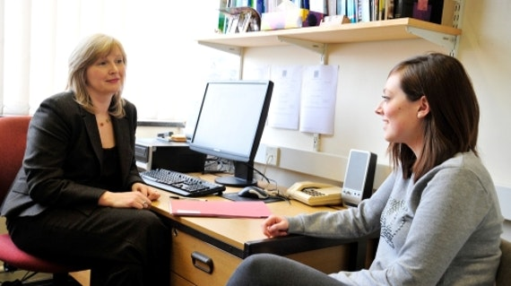
Reflecting & mirroring
More than words

Slide 21
REFLECTING/Mirroring
What it does:
Allows the client to hear her/his thoughts
Improves information exchange
Conveys respect and empathy
Reminds us almost all the answers are in the client
Slows the process and invites the client to take an active role
Helps clients see and work with his or her ambivalence

Slide 22
WHAT WOULD BE REFLECTING?
My teacher called me stupid in front of the whole class. Your reflective response:
You should report her.
What did you do that made her say that?
She is an idiot.
That’s embarrassing.

Slide 23
WHAT WOULD BE REFLECTING?
My wife says she doesn’t find me attractive anymore because of my weight. Your reflective response:
Don’t listen to her. You’re a fine person.
That’s hurtful.
How did that make you feel?
Sounds like good motivation for weight loss!

Slide 24
WHAT WOULD BE REFLECTING?
My doctor just says to take pills for my hypertension. Your reflective response:
It sounds like her advice wasn’t useful to you.
The research does suggest that hypertension medication prevents strokes.
How did that make you feel?
I have better ideas than drugs!
Notes:
We tend to make assumptions about what is said and we might be off. When we say our assumption out loud the client will naturally correct us.
When clients feels respected and heard they will listen to what we have to say and they will experience getting what they need.
There are plenty of things that are true for each client (such as significant obstacles to change) They will not be able to get around them anyway so it aids the process of change when we acknowledge them.
It is easy to get involved in what we need to educate the client about and forget to stay client-centered. Mirroring reminds us to focus on the client.
Any kind of stuck place is a useful time to simply mirror what was just said.
When you feel like a deer in the headlights- simply mirror what you just heard and keep mirroring until something shifts. If nothing else, it gives you a chance to catch your breath. More likely, though, it will give you something in the client that you can respond to.
(The Video in module 12, Help what do I do now? demonstrates this process.)
Helps clients see ambivalence: The first step of working with a client’s ambivalence is to acknowledge it by mirroring the internal conflict that you hear.
Summary of Mirroring: remember that we all naturally mirror in our brains. There is great variability in the extent to which we do it out loud. Observe what types of visible/verbal mirroring you already do naturally and then add some more to your repertoire. Stretch yourself.

Slide 25
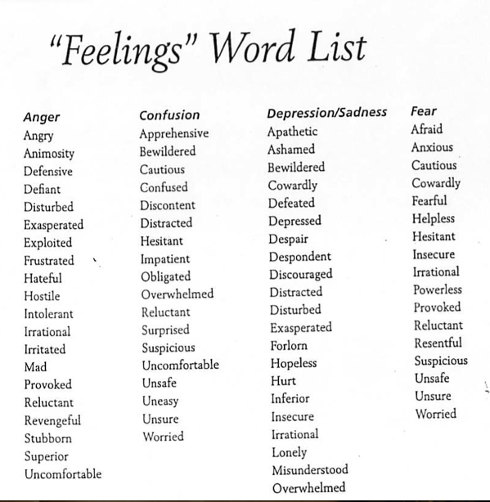

Slide 26
REFLECTING/Mirroring video
https://www.youtube.com/embed/gtYljkOJNKY?rel=0
Notice how Kellogg uses the technique to serve the client.
Notice the phrases Kellogg uses.
See whether you hear reflection
Think about how you would handle the client

Slide 27
Group Practice Affirming and Reflection
Listen to script and identify affirmations and reflections

Slide 28
Practice: Reflection Activity
Find a partner. You will each have a chance to play the client and the counselor.
Client: Be yourself. Talk about something you are trying to decide.
Counselor: Your goal is simply to listen in such a way that your client knows you are listening and “get it.”
Stay with mirroring and reflecting.
Resist asking questions, giving advice or sharing your experience.
Relax, just affirm and reflect. It is not your job to help your partner decide. You are just the sounding board. Even if it begins to feel ridiculous, stick with it.
This is a learning experience. It is meant to be awkward!

Slide 29
1 minute Essay
How confident do you feel about your understanding of mirroring and asking open-ended questions?
What other questions do you have about the course content this week?

